Slide 1

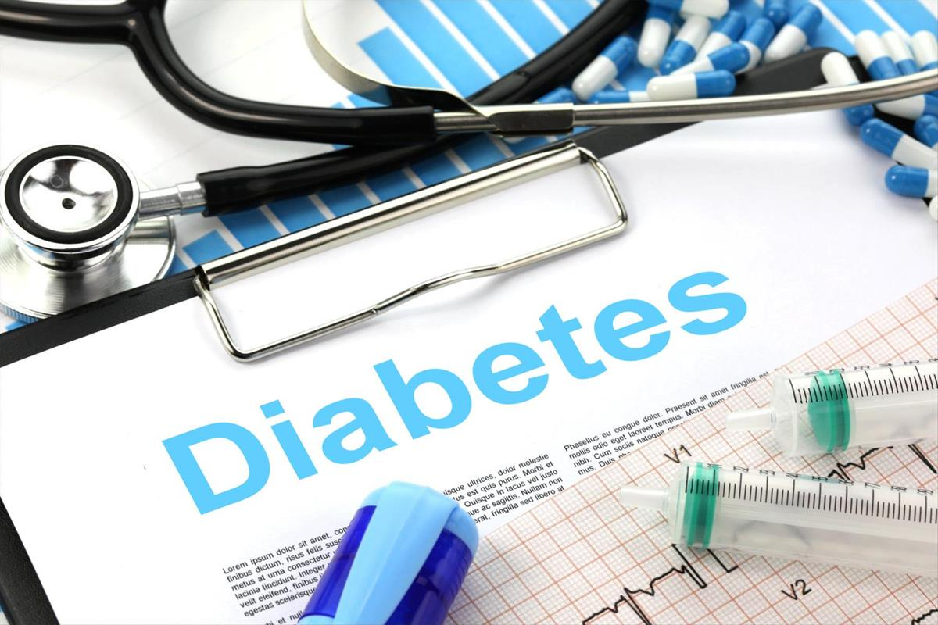
Predicting Diabetes with Classification Models
By
~ Archy Mittal (202401100400046)
~ Ashutosh Kumar Gupta (202401100400058)
~Avesh (202401100400060)
~Ayush Kumar (202401100400064)
~Abhay Pratap Singh (202401100400005)
This Photo by Unknown Author is licensed under CC BY-SA
Notes:
1

Slide 2


Introduction
•This project aims to predict the likelihood of diabetes in patients using machine learning.
•We use a dataset with various health measurements to train a Logistic Regression model.
Steps include data cleaning, exploration, model building, and evaluation
Notes:
2

Slide 3
Dataset Description
•
Contains borrower details like credit score, income, loan amount, loan term, and repayment history
.
Includes both numerical and categorical features
The target variable is binary: 1 (defaulted) or 0 (not defaulted).
Preprocessing includes handling missing values, one-hot encodinging, and feature scaling.
Used to train a machine learning model for predicting loan default.
Notes:
3

Slide 4
Exploratory Data Analysis
•- Displayed first and last 5 rows of the dataset.
•- Summary statistics calculated using describe().
•- Countplot of Outcome variable showed class distribution.
•- Correlation heatmap revealed feature relationships.
Notes:
4

Slide 5
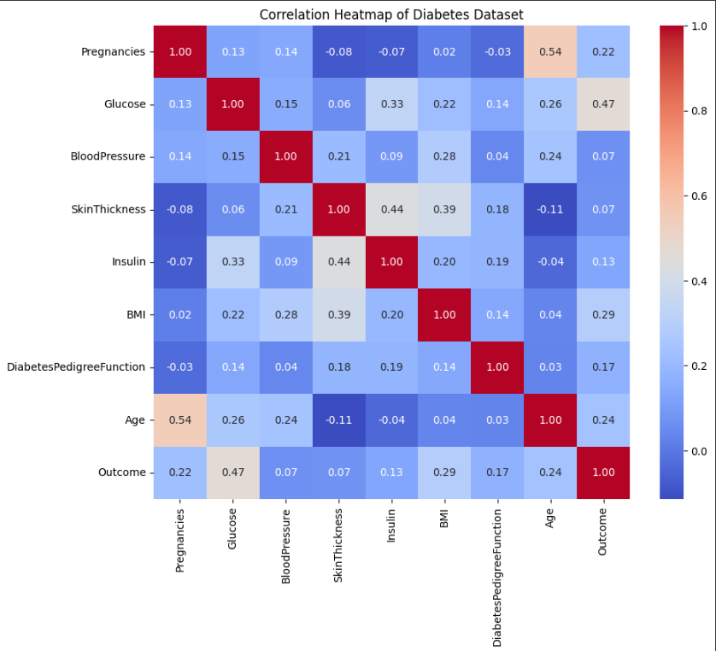
Correlation heatmap
•- Summary statistics calculated using describe().
•- Countplot of Outcome variable showed class distribution.
•- Correlation heatmap revealed feature relationships.
Notes:
5

Slide 6
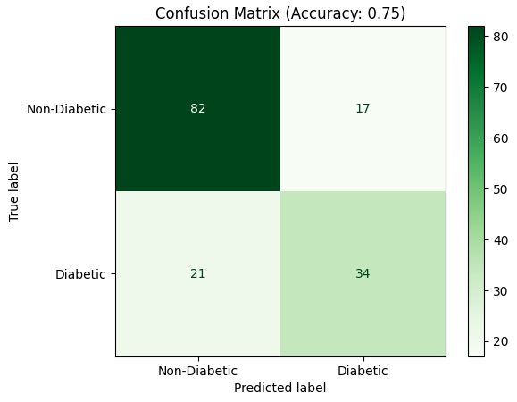
Confusion Matrix Visualization
•- Evaluated using accuracy_score and confusion_matrix.
•- Plotted confusion matrix using ConfusionMatrixDisplay.
- Gave insights into model's performance on test data
Notes:
6

Slide 7
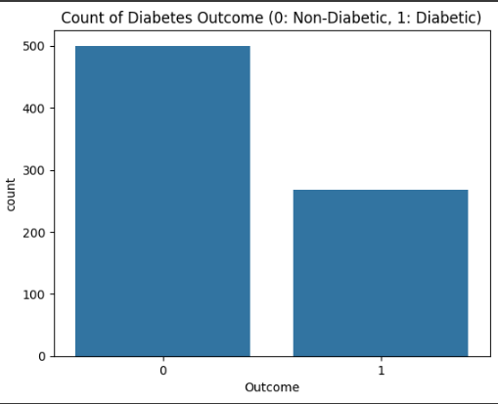
Countplot of target variable
Notes:
7

Slide 8
Model Evaluation
•- Evaluated using accuracy_score and confusion_matrix.
•- Plotted confusion matrix using ConfusionMatrixDisplay.
•- Gave insights into model's performance on test data.
Model Accuracy : 75%
Notes:
8

Slide 9




Key Takeaways and Next Steps
Build and Validate Model
Complete training, tuning, and validation phases.
Deploy Predictive Model
Integrate into healthcare systems for proactive diabetic care.
Enhance with Real-Time Data
Incorporate continuous health monitoring for improved accuracy.
Notes:
9

